Slide 1

Vel Tech Rangarajan Dr. Sagunthala R&D Institute of Science and Technology
School of Computing
Department of Computer Science and Engineering
10211CS224 / FULL STACK APPLICATION DEVELOPMENT (JAVA)
PROJECT REVIEW : MILESTONE PROJECT – 1
Date: 25-03-2026
RESPONSIVE E-COMMERCE INTERFACE WITH STATE-PERSISTENT CART
SDG: 9 – Industry , Innovation and Infrastructure
Presented By:
K.SPANDANA – VTU26084 – 23UECS0765.
Courses Handling Faculty:
Dr.S. Hemamalini M.E.,Ph.D

Slide 2
INTRODUCTION
Background of the problem:
With the rapid growth of online shopping, users expect smooth and seamless experiences across all devices. However, many e-commerce platforms still face issues such as poor responsiveness and inconsistent user interfaces on different screen sizes. One major problem is the loss of cart data when a page is refreshed or the user leaves the site.
Why this project is important:
This project is important because it enhances the overall user experience in online shopping by ensuring that selected items in the cart are not lost due to page refresh or navigation. It reduces user frustration and increases convenience, encouraging users to complete their purchases. A responsive design makes the application accessible across multiple devices, improving usability.
Real-world relevance:
This project reflects real-world e-commerce systems where users expect a seamless and uninterrupted shopping experience. Major online platfoms use persistent carts to retain user selections, improving customer satisfaction and increasing salers. This solution can be directly applied to online retail, food delivery apps, and booking systems
Brief overview of the system:
The system is a responsive e-commerce web application that allows users to browse products, view details, and add items to a shopping cart. It is designed to work seamlessly across different devices such as mobiles, tablets, and desktops.
1
2
3
4
5
6
7
8
9

Slide 3
PROBLEM STATEMENT
Clearly define the problem:
In many existing e-commerce systems, the user interface is not fully responsive, leading to poor usability across different devices such as mobiles, tablets, and desktops. Additionally, shopping cart data is often not preserved when the user refreshes the page or leaves the site, resulting in loss of selected items. This creates inconvenience and reduces user satisfaction. The lack of a persistent cart system affects the overall shopping experience and may lead to cart abandonment. Therefore, there is a need for a responsive and reliable e-commerce interface with a state-persistent cart that ensures data retention and improves usability, efficiency, and user engagement.
1
2
3
4
5
6
7
8
9

Slide 4
OBJECTIVE(S)
To design and develop a responsive e-commerce interface for multi-device compatibility.
To implement a state-persistent cart using local storage for data retention.
To improve user experience by preventing loss of cart items during refresh or navigation.
To evaluate the performance of the system in terms of responsiveness and data persistence.
1
2
3
4
5
6
7
8
9

Slide 5
PROPOSED SYSTEM
Description of your solution:
The proposed system is a responsive e-commerce web application that provides a smooth and user-friendly shopping experience across multiple devices. It displays products with relevant details such as name, price, and images. Users can add or remove items from the shopping cart easily.
How it solves existing issues:
The proposed system addresses the problem of cart data loss by implementing a state-persistent cart using local storage, ensuring that selected items remain saved even after page refresh or navigation. The system reduces user frustration by eliminating the need to reselect products repeatedly.
Advantages over current systems:
Ensures cart data persistence even after page refresh or reopening the application.
Provides a fully responsive design for better usability on mobile,tablet,and desktop devices.
Reduces cart abandonment by retaining user-selected items.
Simplifies user interaction with real-time cart updates(quantity and total price).
1
2
3
4
5
6
7
8
9

Slide 6
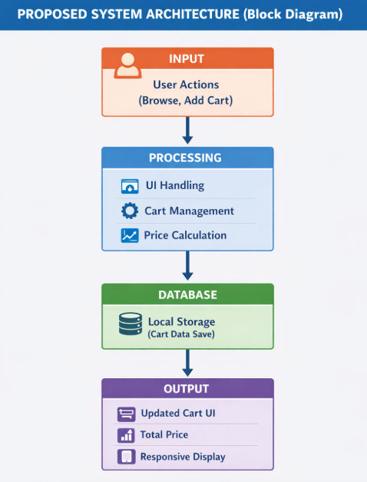
PROPOSED SYSTEM ARCHITECTURE
1
2
3
4
5
6
7
8
9

Slide 7
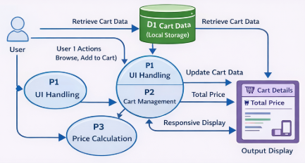
WORKFLOW
1
2
3
4
5
6
7
8
9

Slide 8
TECHNOLOGIES USED
Frontend:
HTML, CSS, JavaScript
Backend:
PHP
Database:
Text File (users.txt) (File-based storage instead of MySQL)
Tools:
-XAMPP Server, Visual Studio Code (or Notepad), Web Browser (Chrome
Hardware/Software Requirements:
-System with minimum 4GB RAM
-Windows OS
-XAMPP installed
-Web browser
1
2
3
4
5
6
7
8
9

Slide 9
MODULE DESCRIPTION
1
Module 1: User Interface Module:
Displays product list with images, price, and details
Provides responsive design for mobile, tablet, and desktop
Handles user interactions like browsing and selecting products
Module 2: Cart Management Module:
Handles adding, removing, and updating cart items
Maintains item quantity and total price dynamically
Provides real-time updates to the cart display
Module 3: Storage Management Module:
Stores cart data using local storage/session storage
Retrieves saved cart data when the user revisits or refreshes
Ensures data persistence without backend dependency
Module 4: Data Processing Module:
Processes user inputs and manages application logic
Calculates total price and updates UI accordingly
Ensures smooth and efficient system performance
2
3
4
5
6
7
8
9

Slide 10
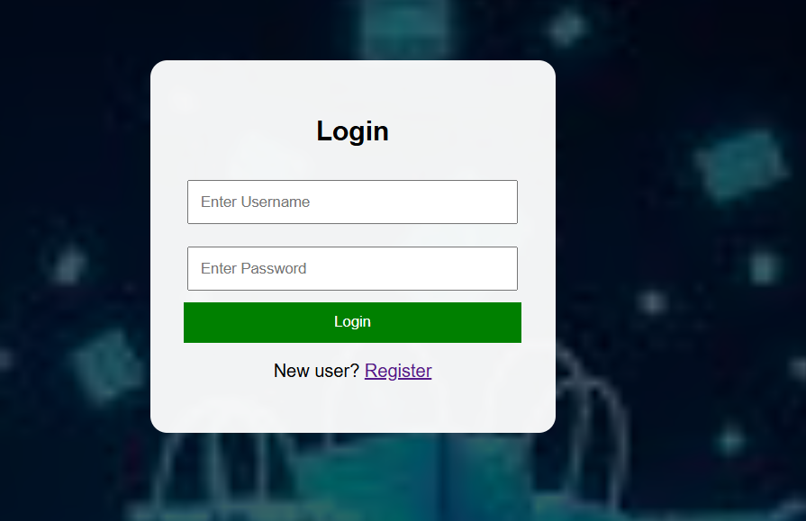
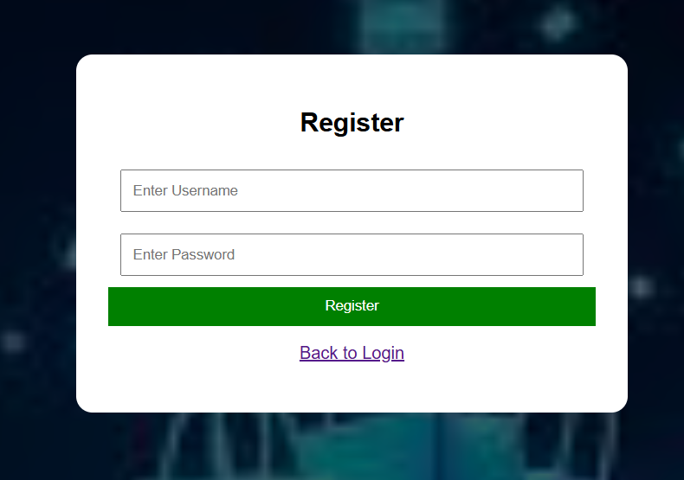
IMPLEMENTATION SCREENSHOTS
Home page
1
2
3
4
5
6
7
8
9

Slide 11
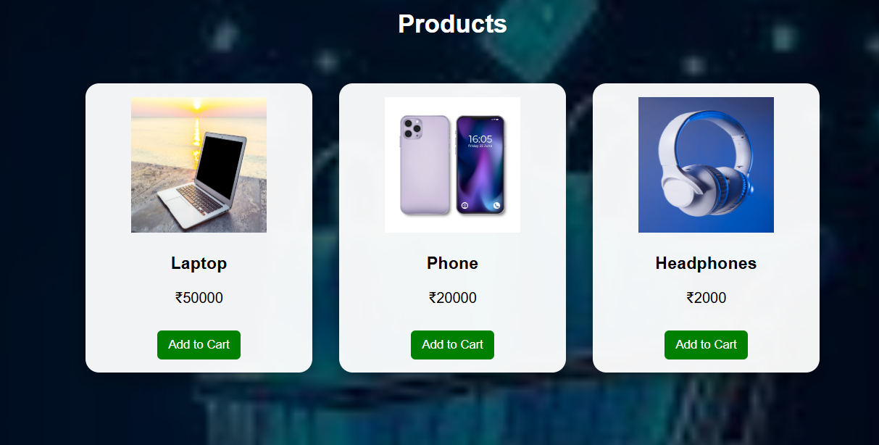
IMPLEMENTATION SCREENSHOTS
1
2
3
4
5
6
7
8(A)
9

Slide 12
ADVANTAGES & LIMITATIONS
1
ADVANTAGES:
Cart data is saved even after page refresh or reopening the site.
Provides a responsive design for mobile, tablet, and desktop users.
Improves user experience by preventing loss of selected items.
Reduces cart abandonment and increases user engagement.
2
3
4
5
6
7
LIMITATIONS:
Depends on browser storage (data may be cleared by user).
Limited storage capacity in local storage.
No backend support in basic version (no user account sync).
Data is not shared across different devices.
8
9

Slide 13
Thank you

